Slide 1
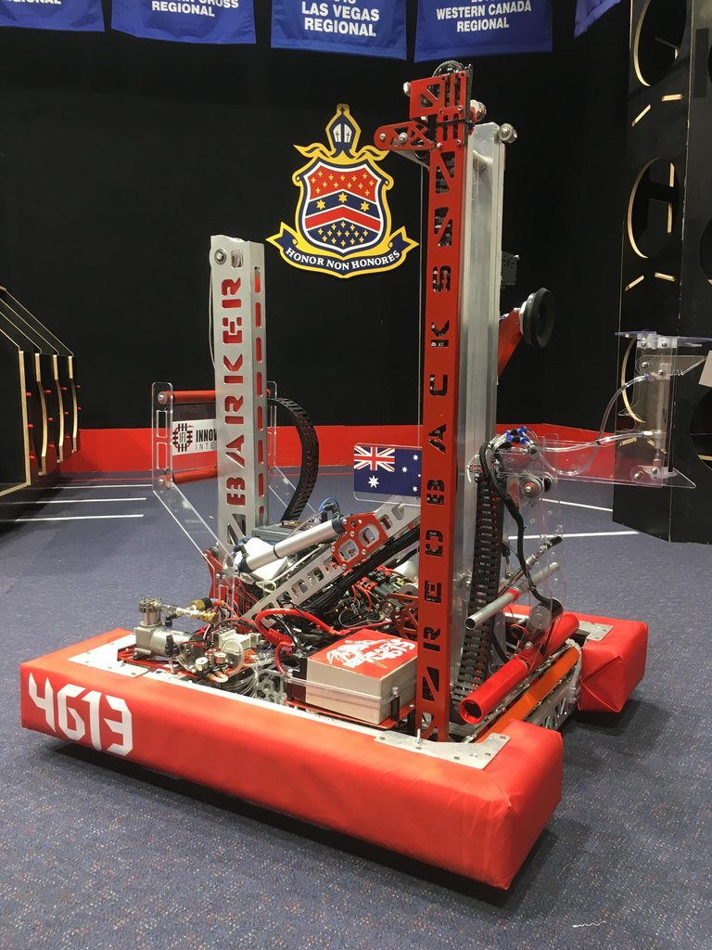

Text Types
Overall Topic: Hardware
Basic Workshop 1.6

Slide 2

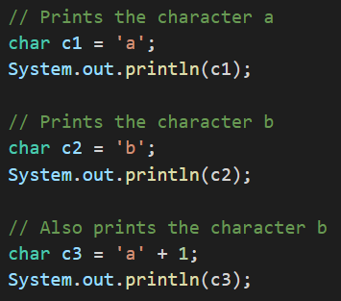
The char primitive type
A char
Is a number from 0 to 65535 (2¹⁶ - 1)
Representing a 16-bit Unicode character
We specify a char’s value in single quotes.

Slide 3
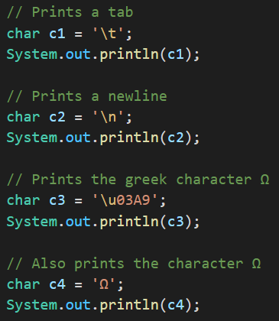
Representing special characters
We can represent special characters with escape sequences:
Backslash followed by a character for common control characters
\uXXXX where XXXX is a 4-digit hexadecimal code for a Unicode character
As backslash starts an escape sequence, we represent an actual backslash with the escape sequence ‘\\’

Slide 4
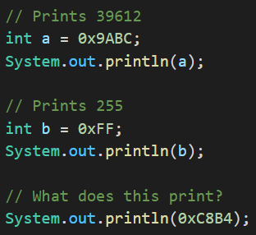
Hexadecimals
Hexadecimals are
Base 16 numbers
Represented with digits from 0 to 9 then A to F
In Java we can specify a hexadecimal number by prefixing it with 0x

Slide 5
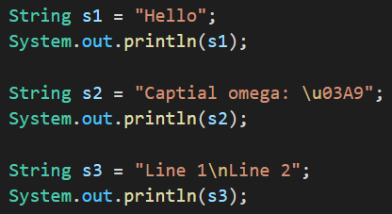
Strings
A String is
A complex datatype
That represents a sequence of chars
Written using the same values as chars, but in double quotes.

Slide 6

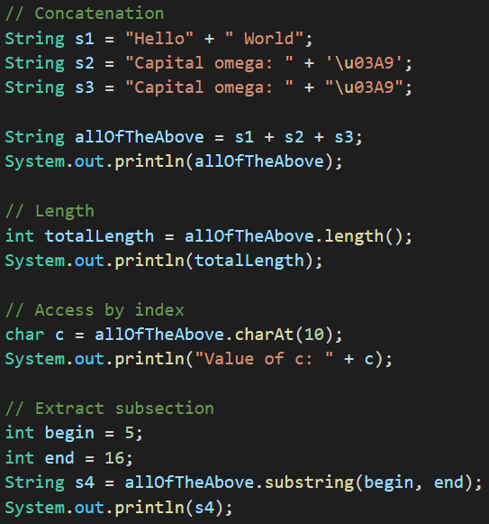
Common string operations
The + operator can be used to add chars or Strings to other Strings
.length() and .charAt(index) allow array-style reading of a String
.substring(begin, end) allows extraction by index of part of a String
The begin index is included in the result, the end is not

Slide 7
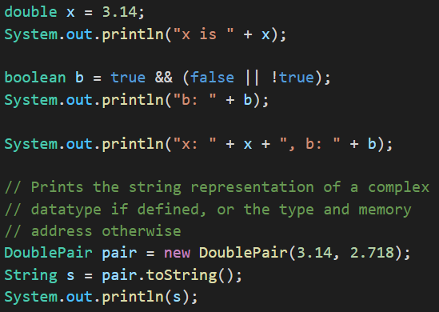
Adding other types to Strings
Adding a value of a different type to a String will automatically convert it to a String
Calling .toString() on a complex type will also convert it to a String

Slide 8
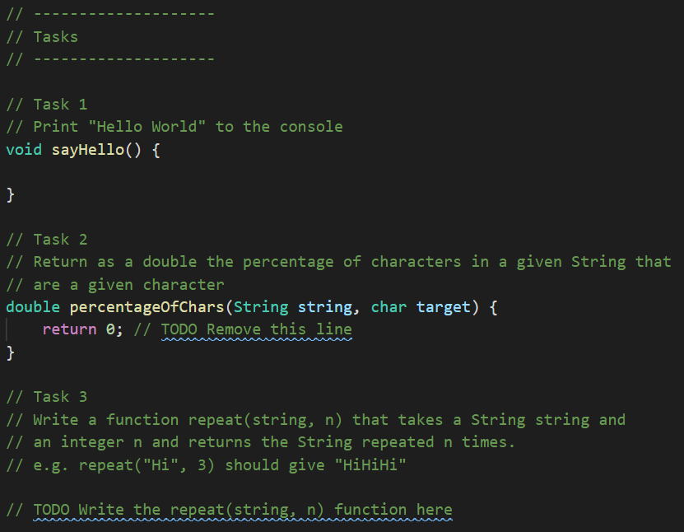
Your turn
Complete the Tasks file for this lesson’s folder.
Remember to update your repository with “git fetch” and “git pull” from Git Bash.

